Slide 1
Natural History of Health conditions &Prevention Dr. Selman Al-kerety

Slide 2
Natural History of Health Conditions:
The natural history of health condition is a description of the events that precedes the development of the health condition , and during its occurrence through the course of development, as well as its outcome (recovery or death).

Slide 3
The natural history of disease
Exposure
Host
Disease
Recovery , disability and death

Slide 4
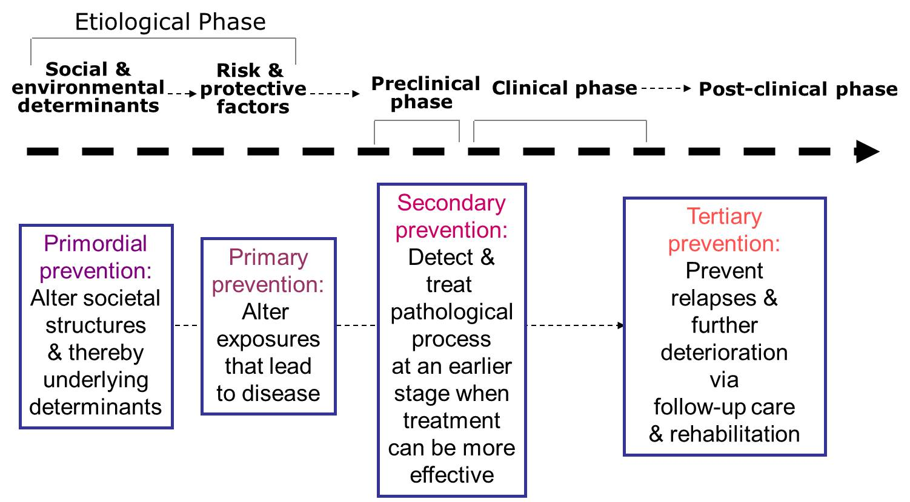
Natural History and Levels of prevention

Slide 5
Q/ Epidemiology is the methods used in the study of disease causations and the body of knowledge. Discuss this statement with explain benefits this knowledge for prevention .

Slide 6
Epidemiology = both methods==== used in the study of:-
disease causations and the body of knowledge (that arises from such investigations)
Body of knowledge such as= natural history of disease, Pattern of disease occurrence, and Factors associated with high risk for developing disease.
This knowledge provides === a framework for planning and evaluating intervention programs ==aimed at primary , secondary and tertiary prevention .

Slide 7
THINK UOY

