Slide 1
Communicable Diseases
Dr. Selman Al-Kerety

Slide 2
Communicable Diseases
They are diseases that spread by direct or indirect contact from infected person to a susceptible host

Slide 3
Epidemiology of Communicable Diseases
Chain of infection: Series of events or conditions that lead to the development of communicable diseases.

Slide 4
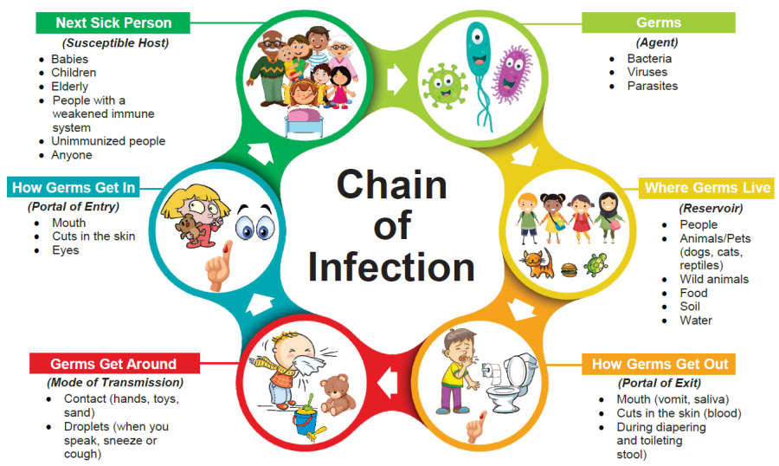

Slide 5
Infectious Agent :Characteristics
Morphology: Color, shape, and size.
Spores : The ability to produce capsules in order to survive.
Life cycle: The nature of life that the agent spend in the host body.
Viability: The ability to survive.
Pathogenicity: The capacity of the agent to cause disease in the infected host.

Slide 6
Infectious Agent :Characteristics
6. Virulence: Refers to the severity of the disease.
7. Infectivity: The capacity of an agent to produce infection or disease
8. Tissue selectivity.
9. Host selectivity.
10 Toxicity: The capacity of the agent to produce a toxin or poison.

Slide 7
Reservoir:
the natural habitat in which an agent lives, grows and multiplies.
Human - persons with symptomatic illness, or may be unapparent or chronic carriers.
Animal - cows, pigs, sheep, raccoons, bats, dogs, cats, birds, rodents etc.
Environmental - plants, water, food and soil.

Slide 8
Portal of Exit:
Path by which an agent leaves its human or animal source host.
Respiratory tract
Urine
Feces
Conjunctiva
Skin lesions
Percutaneous
Placental

Slide 9
The modes of Transmission
It is the means by which the infectious agent which cause the disease transferred to a susceptible host.

Slide 10
Means of Transmission
1. Air-borne transmission: The infectious agent is present in the air and inhaled (inspired) by susceptible host during respiration. ex. Measles.
2.Feco-oral transmission. ex. Hepatitis A , Salmonella.
3. Skin to skin contact.ex. Dermatological diseases,STDs.
4. Transmission by direct inoculation. Transmission through blood. ex. AIDS, Hepatitis B, C and D.
5. Transmission by vectors. ex. Scabies, Malaria

Slide 11
Portal of entry :
The means by which an infectious agent invades the host. This may include the respiratory tract, ingestion, dermal, blood borne, mucous membranes, etc.

Slide 12
Susceptible Host
The person who is at risk for developing an infection from the disease.

Slide 13
factors make a person more susceptible to disease
age (young people and elderly people generally are more at risk),
underlying chronic diseases such as diabetes or asthma,
conditions that weaken the immune system like HIV,
certain types of medications,
invasive devices like feeding tubes, and
malnutrition

Slide 14
Thank you

