Slide 1
Introduction to Epidemiology Dr.Selman Al-Kerety

Slide 2
The term 'epidemiology' was first used in 1802 by the Spanish physician Villalba.
The term is used now for the description and causation of epidemic diseases, and of disease in general.
It can be used for many non-disease health-related conditions, such as high blood pressure and obesity

Slide 3
Definition of epidemiology
Simple Old Definitions
1. Study of the occurrence of illnesses.
2. Study of epidemics and their prevention
3. A branch of medical science which treats epidemics

Slide 4
Modern Definition:
The study of the:
occurrence and distribution
of health-related states or events
IN
specified populations ,
including the study of determinants influencing such states, and the application of this study to control health problems .

Slide 5
Study: Epidemiology is a scientific discipline
Distribution: Epidemiology is concerned with the frequency and pattern of health events in a population.(descriptive epidemiology)
Frequency includes = the number and the rate or risk of disease in the population

Slide 6
Pattern refers to the occurrence of health-related events by :
time,
place, and
personal characteristics

Slide 7
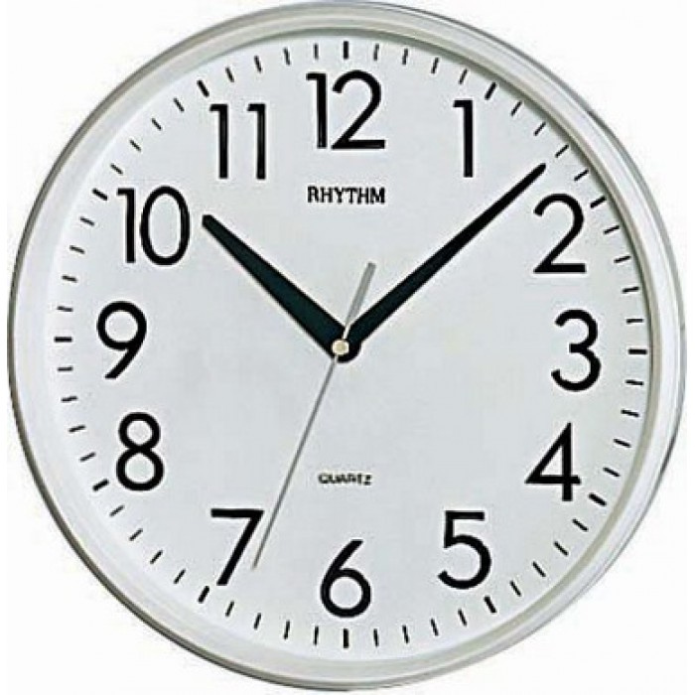
Time

Slide 8
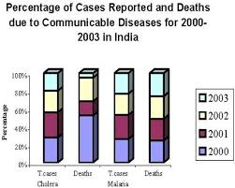
Time

Slide 9
Place

Slide 10
Personal characteristics
Personal characteristics

Slide 11
Personal characteristics (age groups)

Slide 12
Personal characteristics (gender)

Slide 13
What type of distribution ?

Slide 14
Determinants = causes and other factors (Analytic epidemiology ) attempts to provide the Why and How .

Slide 15
Determinants = smoking behavior cause (risk factors for) many health problems

Slide 16
smoking behavior cause (risk factors for) many health problems

Slide 17
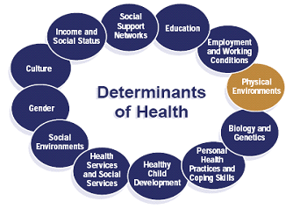

Slide 18
Purpose of Epidemiology:
to provide a basis of:
Data
for developing strategies of:
diseases control and prevention .

Slide 19
Uses of Epidemiology:
.
Identify the nature / extent of health-related events
Designing an intervention and evaluate their effectiveness

Slide 20
Examples of applied epidemiology include the following:
the monitoring of reports of communicable diseases in the community
the study of whether a particular dietary component influences your risk of developing cancer
evaluation of the effectiveness and impact of a cholesterol awareness program
analysis of historical trends and current data to project future public health resource needs

Slide 21
Epidemiological Triangle

Slide 22
Epidemiological Triangle

Slide 23
Interaction between those three elements lead to the occurrence of health problems.

Slide 24
Thank you

