Slide 1
Psychosocial Theories
PREPARED & PRESENTED BY
Instructor /Safi Dakhil Nawam
University of Karbala / college of nursing
Psychiatric–Mental Health Nursing
Fifth edition

Slide 2
Learning Objectives
After reading this chapter, you should be able to
Explain the basic beliefs and approaches of the following psychosocial theories: psychoanalytic, developmental, interpersonal, humanistic, behavioral, existential, and crisis intervention.
Describe the following psychosocial treatment modalities: individual psychotherapy, group psychotherapy, family therapy, behavior modification, systematic desensitization, token economy, self-help groups, support groups, education groups, cognitive therapy, milieu therapy, and psychiatric rehabilitation.
Identify the psychosocial theory on which each treatment strategy is based.
Identify how several of the theoretical perspectives have influenced current nursing practice.

Slide 3
PSYCHOSOCIAL THEORIES
Many theories attempt to explain human behavior, health, and mental illness.
Each theory suggests how normal development occurs based on the theorist’s beliefs, assumptions, and view of the world.
These theories suggest strategies that the clinician can use to work with clients.
Psychoanalytic
Developmental
Interpersonal
Humanistic
Behavioral
Existential

Slide 4
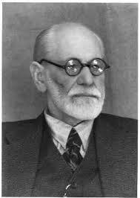
Psychoanalytic Theories Sigmund Freud: The Father of Psychoanalysis
Psychoanalytic theory supports the notion that all human behavior is caused and can be explained (deterministic theory). نتيجة حتمية لاسباب سابقة
Freud believed that repressed (driven from conscious awareness) sexual impulses and desires motivate much human behavior.
He developed his initial ideas and explanations of human behavior from his experiences with a few clients, all of them women who displayed unusual behaviors such as disturbances of sight and speech, inability to eat, and paralysis of limbs.

Slide 5
Psychoanalytic Theories cont. Sigmund Freud: The Father of Psychoanalysis
These symptoms had no physiological basis, so Freud considered them to be the “hysterical” or neurotic behavior of women.
After several years of working with these women, Freud concluded that many of their problems resulted from childhood trauma or failure to complete tasks of psychosexual development.
These women repressed their unmet needs and sexual feelings as well as traumatic events. The “hysterical” or neurotic behaviors resulted from these unresolved conflicts.

Slide 6
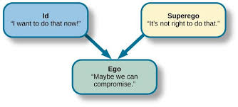
Personality Components: Id, Ego, and Superego.
Three components: id, ego, and superego (Freud, 1923/1962).
The id is the part of one’s nature that reflects basic or essential desires such as pleasure-seeking behavior, aggression, and sexual impulses.
The id seeks immediate gratification, causes impulsive unthinking behavior, and has no regard for rules or social agreement.

Slide 7
Personality Components: Id, Ego, and Superego cont.
The superego is the part of a person’s nature that reflects moral and ethical concepts, values, and parental and social expectations; therefore, it is in direct opposition to the id.

Slide 8
Personality Components: Id, Ego, and Superego cont.
The third component, the ego, is the balancing or mediating force between the id and the superego.
The ego represents mature and adaptive behavior that allows a person to function successfully in the world.
Freud believed that anxiety resulted from the ego’s attempts to balance the impulsive instincts of the id with the stringent rules of the superego.

Slide 9
Behavior Motivated by Subconscious Thoughts and Feelings.
Freud believed that the human personality functions at three levels of awareness: conscious, preconscious, and unconscious (Freud, 1923/1962).
Conscious refers to the perceptions, thoughts, and emotions that exist in the person’s awareness, such as being aware of happy feelings or thinking about a loved one.
Preconscious thoughts and emotions are not currently in the person’s awareness, but that the woman fears intimacy with men; he would view the snake as a phallic symbol, representing the penis.

Slide 10
Behavior Motivated by Subconscious Thoughts and Feelings cont.
subconscious
Another method used to gain access to subconscious thoughts and feelings is free association, in which the therapist tries to uncover the client’s true thoughts and feelings by saying a word and asking the client to respond quickly with the first thing that comes to mind.
Freud believed that such quick responses would be likely to uncover subconscious or repressed thoughts or feelings.

Slide 11
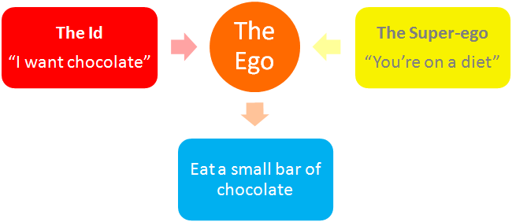
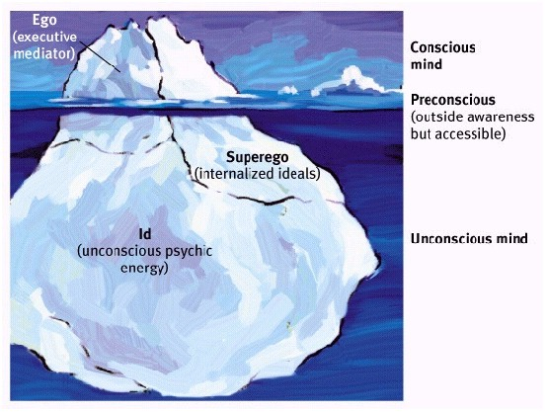

Slide 12
EGO DEFENSE MECHANISMS
Compensation
Conversion
Denial
Displacement
Dissociation
Fixation
Identification
Intellectualization
Introjection
Projection
Rationalization
Reaction formation
Regression
Repression
Resistance
Sublimation
Substitution
Suppression
Undoing

Slide 13
Five Stages of Psychosexual Development.
Freud based his theory of childhood development on the belief that sexual energy, termed libido, was the driving force of human behavior.
He proposed that children progress through five stages of psychosexual development:
Oral (birth to 18 months)
Anal (18 to 36 months)
Phallic/oedipal (3 to 5 years)
Latency (5 to 11 or 13 years)
Genital (11 to 13 years).

Slide 16
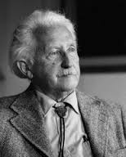
Developmental Theories Erik Erikson and Psychosocial Stages of Development
Erik Erikson (1902–1994) was a German-born psychoanalyst who extended Freud’s work on personality development across the life span while focusing on social and psychological development in the life stages.
In 1950, Erikson published Childhood and Society, in which he described eight psychosocial stages of development.
In each stage, the person must complete a life task that is essential to his or her well-being and mental health.
These tasks allow the person to achieve life’s qualities: hope, purpose, fidelity, love, caring, and wisdom.

Slide 17
Erik Erikson and Psychosocial Stages of Development cont.
The stages, life tasks, and qualities are described in this slide .
In the infant stage (birth to 18 months), trust versus mistrust, the infant must learn to develop basic trust (the positive outcome) such as that he or she will be fed and taken care.
The formation of trust is essential: mistrust, the negative outcome of this stage, will impair the person’s development throughout his or her life.

Slide 18
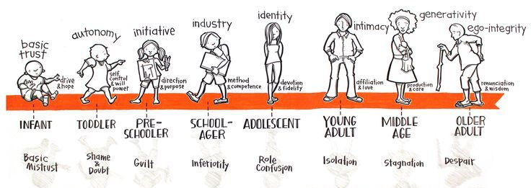
مرحلة التكامل مقابل اليأس | مرحلة الإنتاج مقابل الركود | مرحلة الألفة مقابل العزلة | مرحلة تحديد الهوية مقابل اضطراب الهوية | مرحلة الانجاز مقابل الشعور بالنقص | مرحلة المبادرة مقابل الشعور بالذنب | مرحلة الاستقلال مقابل الشعور بالخجل والشك | مرحلة الثقة مقابل عدم الثقة

Slide 19
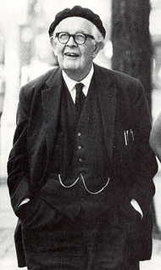
Jean Piaget and Cognitive Stages of Development
Jean Piaget (1896–1980) explored how intelligence and cognitive functioning develop in children.
He believed that human intelligence progresses through a series of stages based on age, with the child at each successive stage demonstrating a higher level of functioning than at previous stages.
In his schema, Piaget strongly believed that biologic changes and maturation were responsible for cognitive development.

Slide 20
Piaget’s four stages of cognitive development are as follows:
Sensorimotor—birth to 2 years:
The child develops a sense of self as separate from the environment and the concept of object permanence; that is, tangible objects do not cease to exist just because they are out of sight. He or she begins to form mental images.
Preoperational—2 to 6 years:
The child develops the ability to express self with language, understands the meaning of symbolic gestures, and begins to classify objects.
Concrete operations—6 to 12 years:
The child begins to apply logic to thinking, understands spatiality and reversibility, and is increasingly social and able to apply rules; however, thinking is still concrete.
Formal operations—12 to 15 years and beyond:
The child learns to think and reason in abstract terms, further develops logical thinking and reasoning, and achieves cognitive maturity.

Slide 21
Suggests of Piaget’s Theory
Piaget’s theory suggests that individuals reach cognitive maturity by middle to late adolescence.
Some critics of Piaget believe that cognitive development is less rigid and more individualized than his theory suggests.
Piaget’s theory is useful when working with children.
The nurse may better understand what the child means if the nurse is aware of his or her level of cognitive development.
Also, teaching for children is often structured with their cognitive development in mind.

Slide 22
Interpersonal Theories Harry Stack Sullivan: Interpersonal Relationships and Milieu Therapy
Harry Stack Sullivan (1892–1949) was an American psychiatrist who extended the theory of personality development to include the significance of interpersonal relationships.
Sullivan believed that one’s personality involves more than individual characteristics, particularly how one interacts with others.
He thought that inadequate or no satisfying relationships produce anxiety, which he saw as the basis for all emotional problems (Sullivan, 1953).
The importance and significance of interpersonal relationships in one’s life is probably Sullivan’s greatest contribution to the field of mental health.

Slide 23
Five Life Stages.
Sullivan established five life stages of development—infancy, childhood, juvenile, preadolescence, and adolescence, each focusing on various interpersonal relationships.
Sullivan also described three developmental cognitive methods of experience and believed that mental disorders are related to the persistence of one of the early methods.
The prototaxic mode, characteristic o infancy and childhood, involves brief, unconnected experiences that have no relationship to one another. Adults with Schizophrenia exhibit persistent prototaxic experiences.

Slide 24
Three developmental cognitive methods
The parataxic mode begins in early childhood as the child begins to connect experiences in sequence. The child may not make logical sense of the experiences and may see them as a chance events. The child seeks to relieve anxiety by repeating familiar experiences, although he or she may not understand what he or she is doing. Sullivan explained paranoid ideas and slips of the tongue as a person operating in the parataxic mode.
In the syntaxic mode, which begins to appear in school-aged children and becomes more predominant in preadolescence, the person begins to perceive himself or herself and the world within the context of the environment and can analyze experiences in a variety of settings. Maturity may be defined as predominance of the syntaxic mode (Sullivan, 1953).

Slide 25
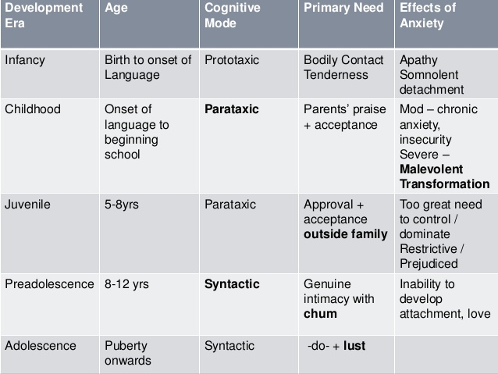
Sullivan's five life stages of development

Slide 26
Therapeutic Community or Milieu.
Sullivan envisioned the:
Goal of treatment as the establishment of satisfying interpersonal relationships.
The therapist provides a corrective interpersonal relationship for the client.
Sullivan created the term participant observer for the therapist’s role, meaning that the therapist both participates in and observes the progress of the relationship.
Sullivan is also credited with developing the first therapeutic community or milieu with young men with schizophrenia in 1929
In the concept of therapeutic community or milieu, the interaction among clients is seen as beneficial, and treatment emphasizes the role of this client-to-client interaction.
Until this time, it was believed that the interaction between the client and the psychiatrist was the one essential component to the client’s treatment.
The concept of milieu therapy, originally developed by Sullivan, involved clients’ interactions with one another including:
Practicing interpersonal relationship skills
Giving one another feedback about behavior
Working cooperatively as a group to solve day-to-day problems.
Management of the milieu, or environment, is still a primary role for the nurse in terms of providing safety and protection for all clients and promoting social interaction.

Slide 27
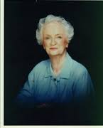
Hildegard Peplau: Therapeutic Nurse–Patient Relationship
Hildegard Peplau was a nursing theorist and clinician who built on Sullivan’s interpersonal.
Hildegard Peplau, who developed the phases of the nurse–client therapeutic relationship, which has made great contributions to the foundation of nursing practice today.
Theories and also saw the role of the nurse as a participant observer.
Peplau developed the concept of the therapeutic nurse– patient relationship, which includes four phases: orientation, identification, exploitation, and resolution
During these phases, the client accomplishes certain tasks and makes relationship changes that help the healing process (Peplau, 1952).

Slide 28
PEPLAU’S STAGES AND TASKS OF RELATIONSHIPS
Stage | Tasks
Orientation | Patient’s problems and needs are clarified. Patient asks questions. Hospital routines and expectations are explained. Patient connects energy toward meeting problems. Patient’s full participation is prompted.
Identification | Patient responds to persons he or she notices as helpful. Patient feels stronger. Patient expresses feelings. Interdependent work with the nurse occurs. Roles of both patient and nurse are clarified.
Exploitation | Patient makes full use of available services. Goals such as going home and returning to work arise. Patient’s behaviors fluctuate between dependence and independence.
Resolution | Patient gives up dependent behavior. Services are no longer needed by patient. Patient assumes power to meet own needs, set new goals, and so forth.

Slide 29
Roles of the Nurse in the Therapeutic Relationship.
Peplau also wrote about the roles of the nurse in the therapeutic relationship and how these roles help meet the client’s needs. The primary roles she identified are as follows:
Stranger––offering the client the same acceptance and courtesy that the nurse would to any stranger;
Resource person––providing specific answers to questions within a larger context
Teacher––helping the client to learn formally or informally;
Leader––offering direction to the client or group;
Surrogate––serving as a substitute for another such as a parent or sibling;
Counselor––promoting experiences leading to health for the client such as expression of feelings.

Slide 30
Four Levels of Anxiety.
Peplau defined anxiety as the initial response to a psychic threat.
She described four levels of anxiety: mild, moderate, severe, and panic .
These serve as the foundation for working with clients with anxiety in a variety of contexts.
Mild anxiety is a positive state of heightened awareness and sharpened senses, allowing the person to learn new behaviors and solve problems.
Moderate anxiety involves a decreased perceptual field (focus on immediate task only
Severe anxiety involves feelings of dread or terror. The person cannot be redirected to a task; he or she focuses only on scattered details and has physiological symptoms of tachycardia, diaphoresis, and chest pain.
Panic anxiety can involve loss of rational thought, delusions, hallucinations, and complete physical immobility and muteness.

Slide 31
Humanistic theories:
Humanism represents a significant shift away from the psychoanalytic view of the individual as a neurotic, impulse-driven person with repressed psychic problems and away from the focus on and examination of the client’s past experiences.
Humanism focuses on a person’s positive qualities, his or her capacity to change (human potential), and the promotion of self-esteem. Humanists do consider the person’s past experiences, but they direct more attention toward the present and future.

Slide 32
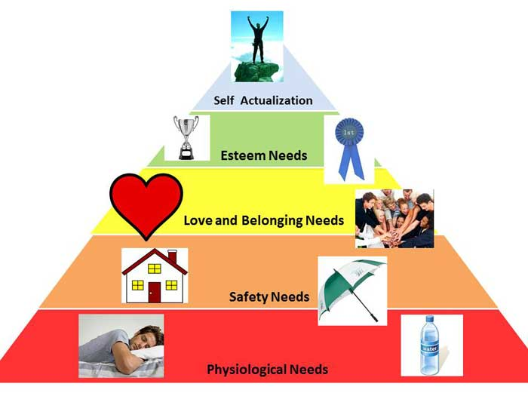
Abraham Maslow: Hierarchy of Needs

Slide 33
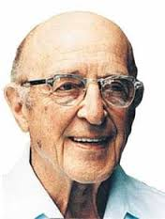
Carl Rogers: Client-Centered Therapy
Carl Rogers (1902–1987) was a humanistic American psychologist who focused on the therapeutic relationship and developed a new method of client-centered therapy.
Rogers was one of the first to use the term client rather than patient.
Client-centered therapy focuses on the role of the client, rather than the therapist, as the key to the healing process.
Rogers believed that each person experiences the world differently and knows his or her own experience best (Rogers, 1961).
According to Rogers, clients do “the work of healing,” and within a supportive and nurturing client–therapist relationship, clients can cure themselves.
Clients are in the best position to know their own experiences and make sense of them, to regain their self-esteem, and to progress toward self-actualization.
The therapist takes a person-centered approach, a supportive role, rather than a directive or expert role, because Rogers viewed the client as the expert on his or her life.

Slide 34
Carl Rogers: Client-Centered Therapy cont.
The therapist must promote the client’s self-esteem as much as possible through three central concepts:
Unconditional positive regard— regard التقدير الإيجابي غير المشروط يعزز ثقة العميل بنفسه a nonjudgmental caring for the client that is not dependent on the client’s behavior
Genuineness—realness or congruence between what the therapist feels and what he or she says to the client
Empathetic understanding—in which the therapist senses the feelings and personal meaning from the client and communicates this understanding to the client.

Slide 35
Carl Rogers: Client-Centered Therapy cont.
Unconditional positive regard promotes the client’s self-esteem and decreases his or her need for defensive behavior.
As the client’s self-acceptance grows, the natural self-actualization process can continue. Rogers also believed that the basic nature of humans is to become self-actualized, or to move toward self-improvement and constructive change.
We are all born with a positive self-regard and a natural inclination to become self-actualized. If relationships with others are supportive and nurturing, the person retains feelings of self-worth and progresses toward self-actualization, which is healthy.
If the person encounters repeated conflicts with others or is in non-supportive relationships, he or she loses self-esteem, becomes defensive, and is no longer inclined toward self-actualization; this is not healthy.

Slide 36
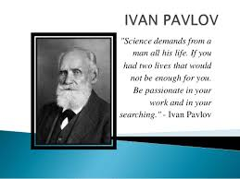
Behavioral theories: Ivan Pavlov: Classical Conditioning
Laboratory experiments with dogs provided the basis for the development of Ivan Pavlov’s theory of classical conditioning:
Behavior can be changed through conditioning with external or environmental conditions or stimuli.
Pavlov’s experiment with dogs involved his observation that dogs naturally began to salivate (response) when they saw or smelled food (stimulus).
Pavlov (1849–1936) set out to change this salivating response or behavior through conditioning.
He would ring a bell (new stimulus), then produce the food, and the dogs would salivate (the desired response).
Pavlov repeated this ringing of the bell along with the presentation of food many times.
Eventually he could ring the bell and the dogs would salivate without seeing or smelling food. The dogs had been “conditioned,” or had learned a new response—to salivate when they heard the bell.
Their behavior had been modified through classical conditioning, or a conditioned response.

Slide 37
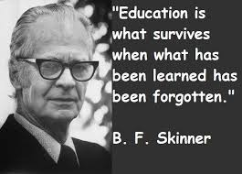
B. F. Skinner: Operant Conditioning
One of the most influential behaviorists was B. F. Skinner (1904–1990), an American psychologist.
He developed the theory of operant conditioning, which says people learn their behavior from their history or past experiences, particularly those experiences that were repeatedly reinforced.
Although some criticize his theories for not considering the role that thoughts, feelings, or needs play in motivating behavior, his work has provided several important principles still used today.
Skinner did not deny the existence of feelings and needs in motivation; however, he viewed behavior as only that which could be observed, studied, and learned or unlearned.
He maintained that if the behavior could be changed, then so too could the accompanying thoughts or feelings.
Changing the behavior was what was important.

Slide 38
The following principles of operant conditioning described by Skinner (1974) form the basis for behavior techniques in use today:
All behavior is learned.
Consequences result from behavior—broadly speaking, reward and punishment.
Behavior that is rewarded with reinforcers tends to recur.
Positive reinforcers that follow a behavior increase the likelihood that the behavior will recur.
Negative reinforcers that are removed after a behavior increase the likelihood that the behavior will recur.
Continuous reinforcement (a reward every time the behavior occurs) is the fastest way to increase that behavior, but the behavior will not last long after the reward ceases.
Random intermittent reinforcement (an occasional reward for the desired behavior) is slower to produce an increase in behavior, but the behavior continues after the reward ceases.

Slide 39
Existential Theories:
Existential theorists believe that behavioral deviations result when a person is out of touch with himself or herself or the environment.
The person who is self-alienated is lonely and sad and feels helpless.
Lack of self-awareness, coupled with harsh self-criticism, prevents the person from participating in satisfying relationships.
The person is not free to choose from all possible alternatives because of self-imposed restrictions.
Existential theorists believe that the person is avoiding personal responsibility and giving in to the wishes or demands of others.
All existential therapies have the goal of helping the person discover an authentic sense of self.
They emphasize personal responsibility for one’s self, feelings, behaviors, and choices.
These therapies encourage the person to live fully in the present and to look forward to the future.
Carl Rogers is sometimes grouped with existential therapists.

Slide 40
Existential therapies.
Cognitive Therapy
Rational Emotive Therapy
Viktor Frankl and Logotherapy
Gestalt Therapy
Reality Therapy

